Slide 1
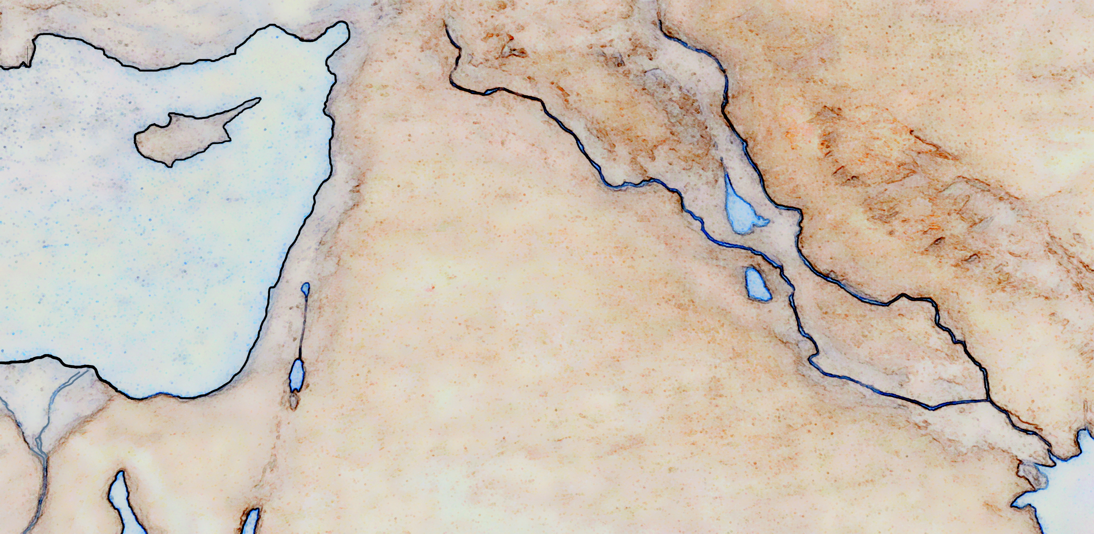





Taurus Mountains
Heth
Haran
Nineveh
Assyria
Mt.
Tsaphon
ELISHAH
Asshur
Euphrates River
Tigris River
Zagros Mountains
Great Sea
Babylon
Sidon
Tyre
bashan
Mt.
Carmel
Israel
Babel
Shechem
Jordan River
Jerusalem
Tsaphon
Zoan
Salt
Sea
Negev
Desert
Ur
On
Egypt
Yam
Qadim
memphis
The
Wilderness
Nile river
Red Sea
Negev
Midian

Slide 3
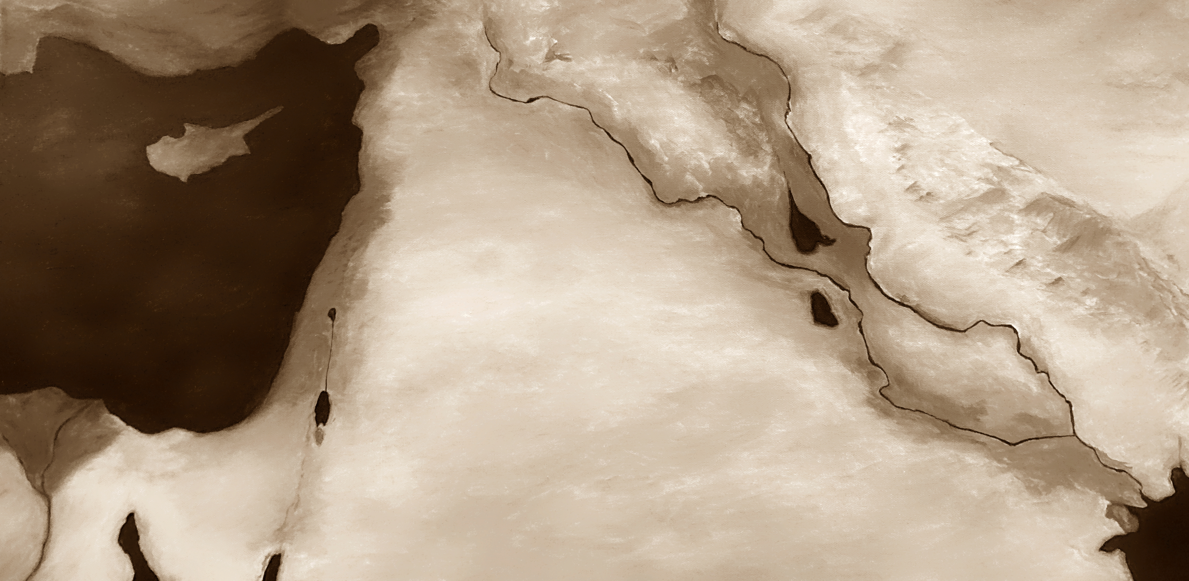
Taurus Mountains
Heth
Haran
Nineveh
Assyria
Mt.
Tsaphon
ELISHAH
Asshur
Euphrates River
Tigris River
Great Sea
Zagros Mountains
Babylon
Sidon
Tyre
bashan
Mt.
Carmel
Israel
Babel
Shechem
Jordan River
Jerusalem
Tsaphon
Zoan
Salt
Sea
Negev
Desert
Ur
On
Egypt
Yam
Qadim
memphis
The
Wilderness
Nile river
Red Sea
Negev
Midian

Slide 5
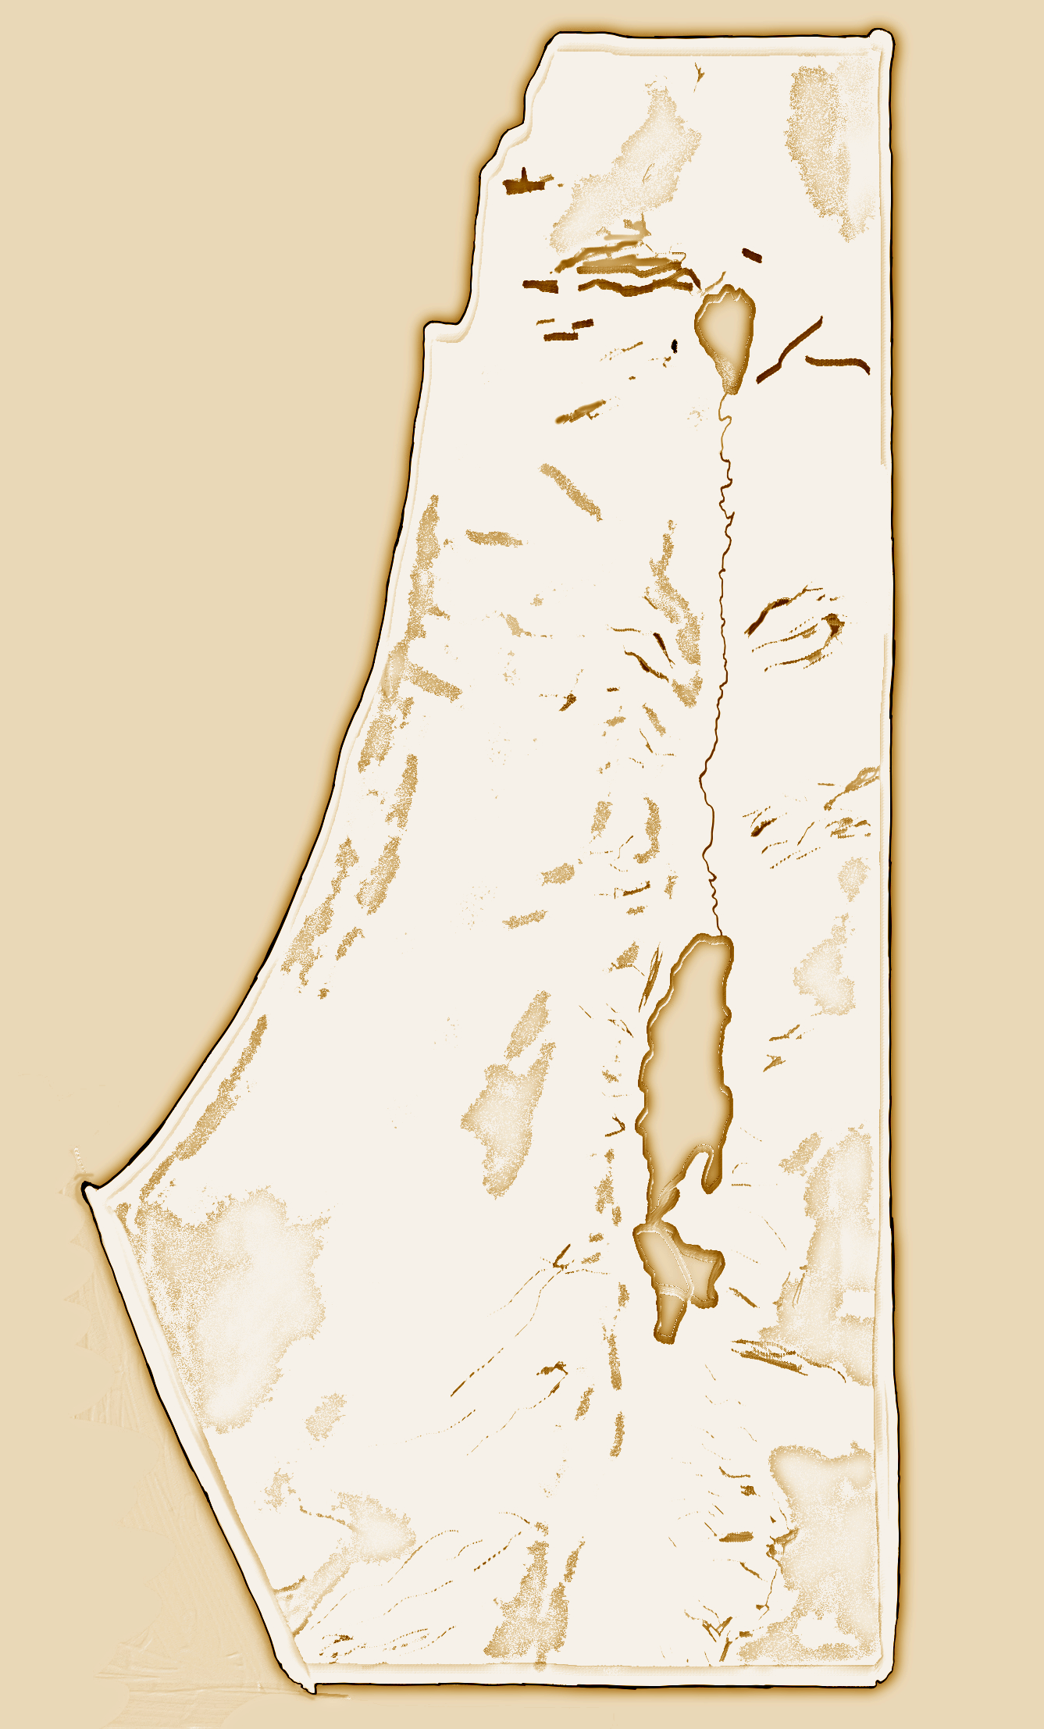
sea of
galilee
JORDAN RIVER
jerusalem
SALT
sea

Slide 6
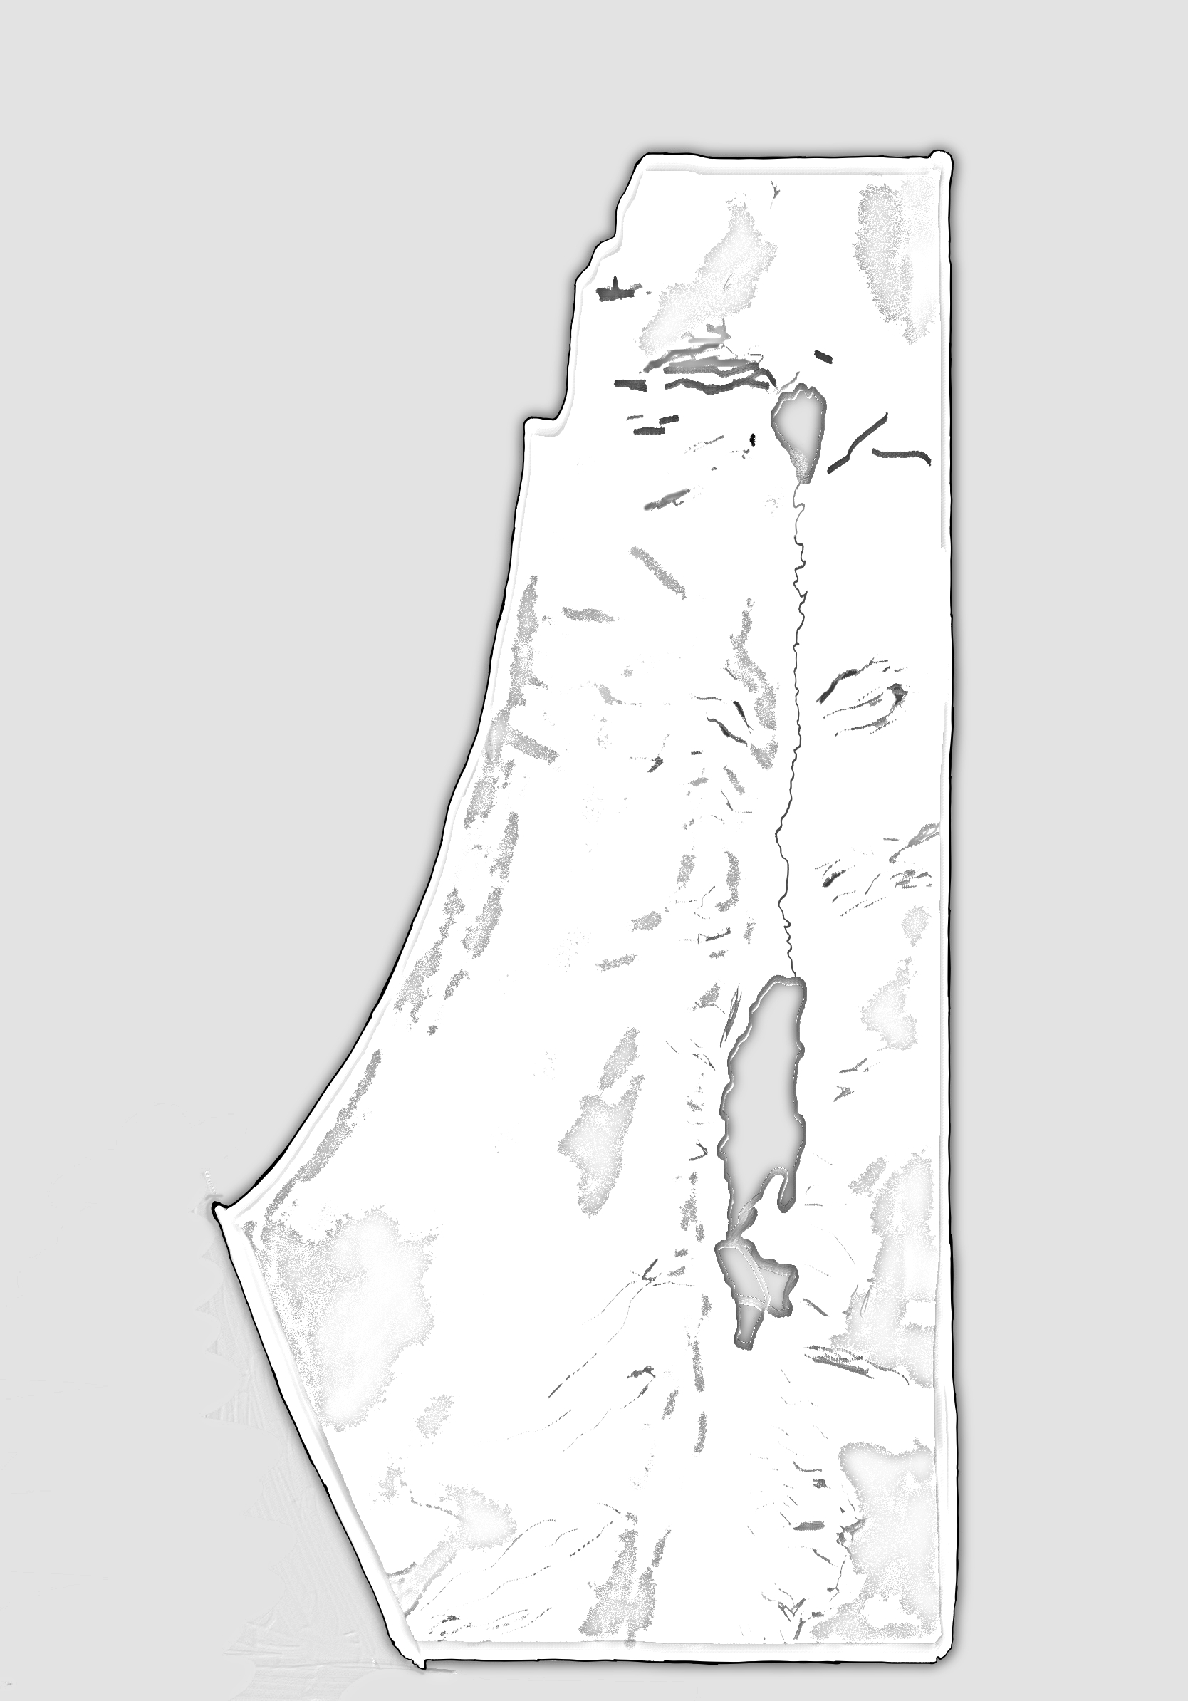

Slide 7
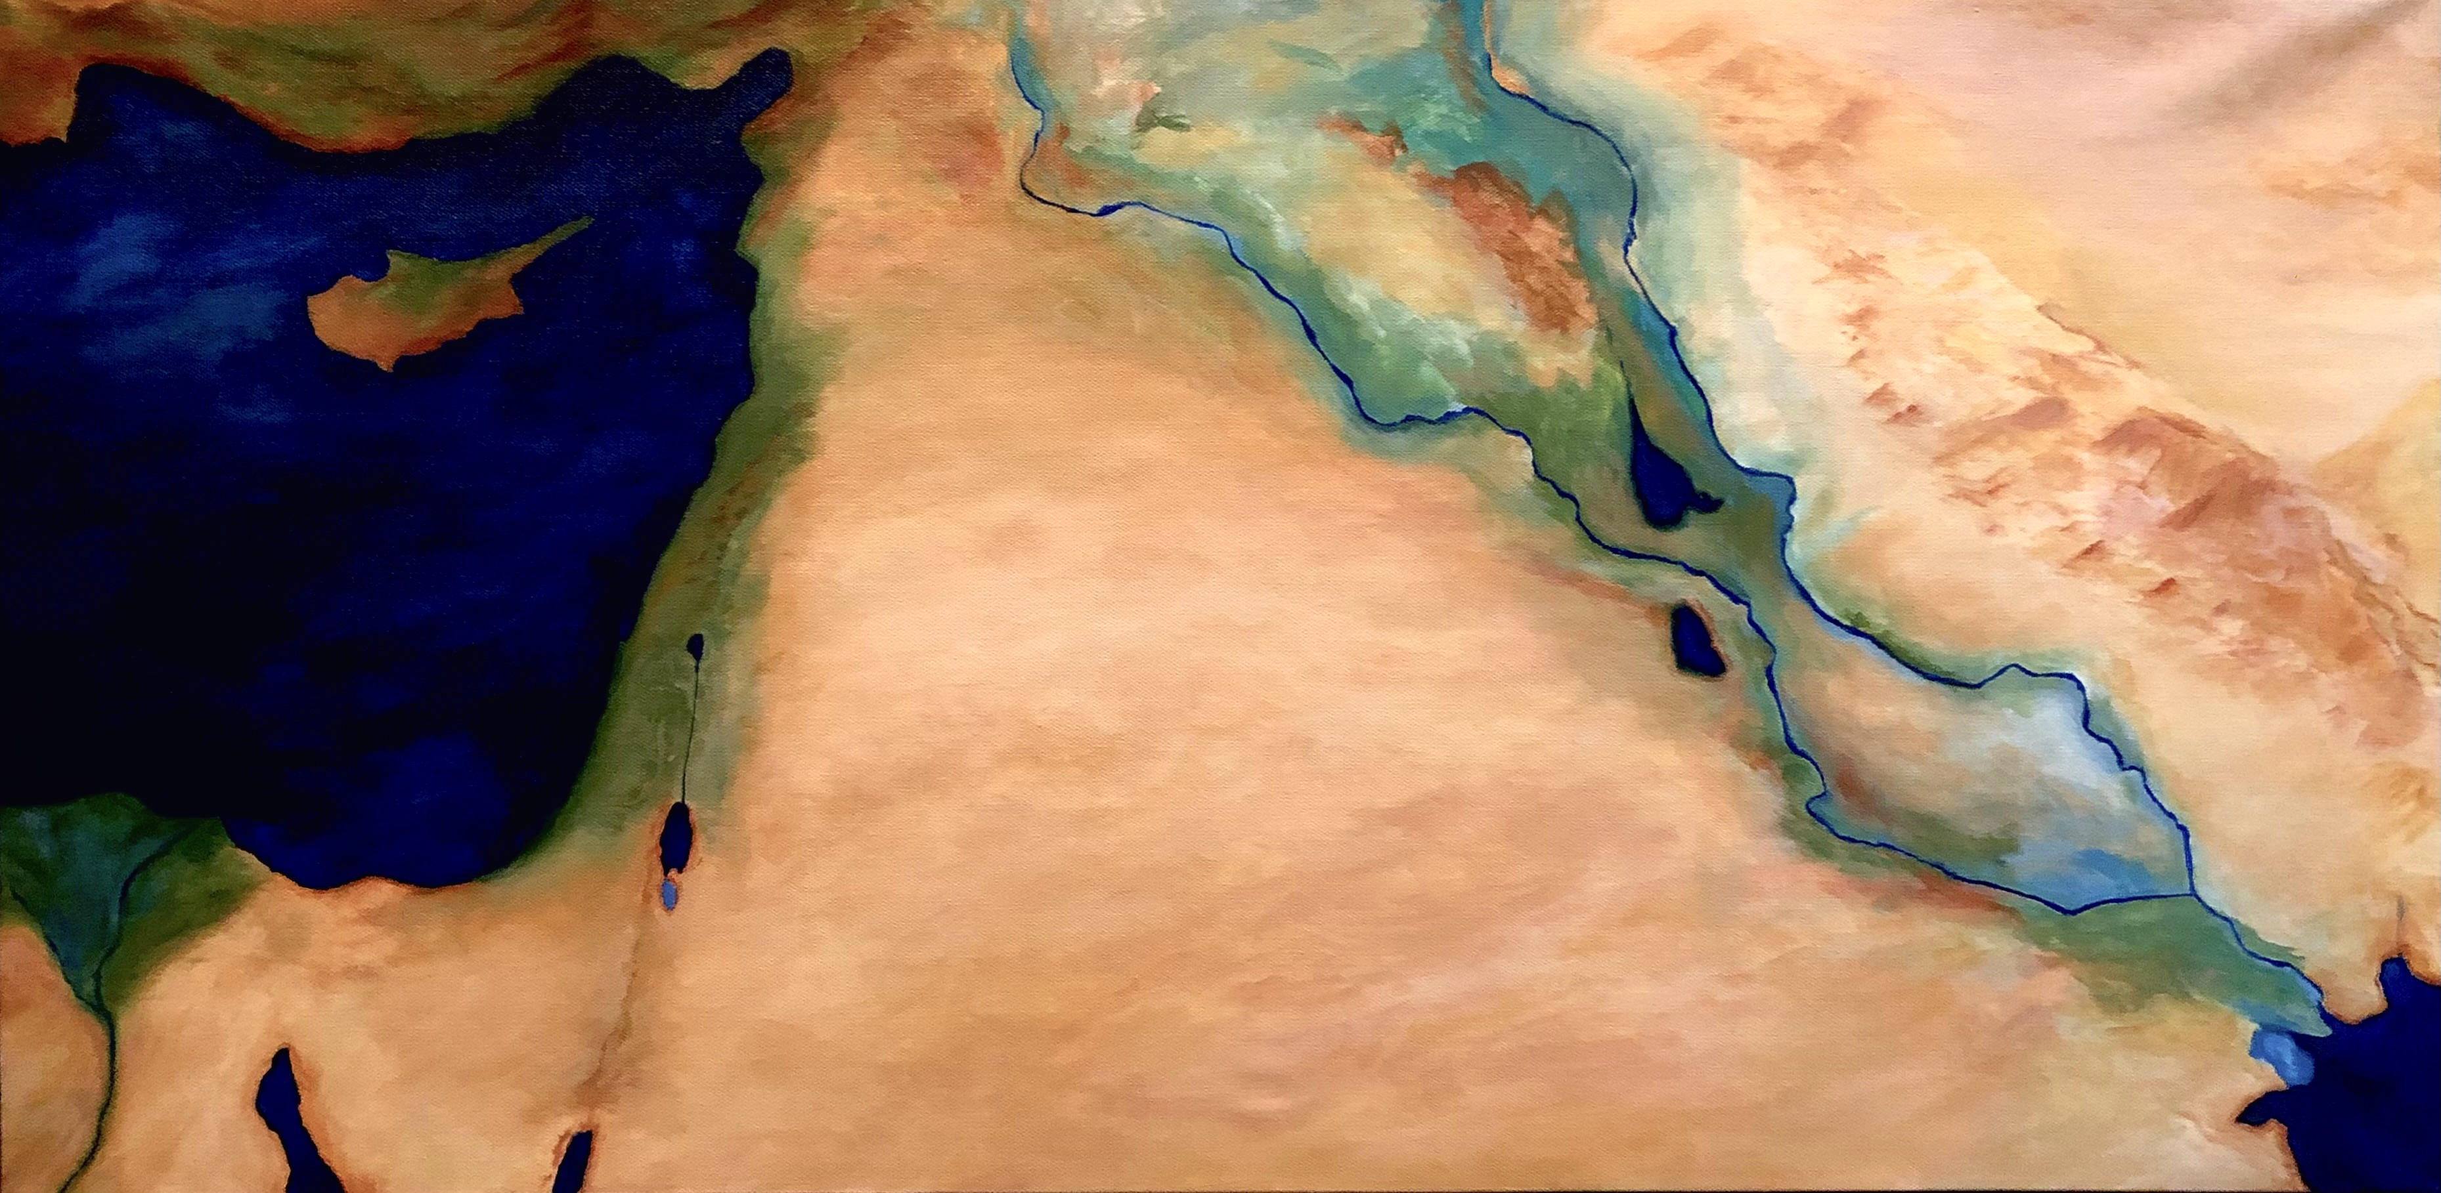

Slide 8
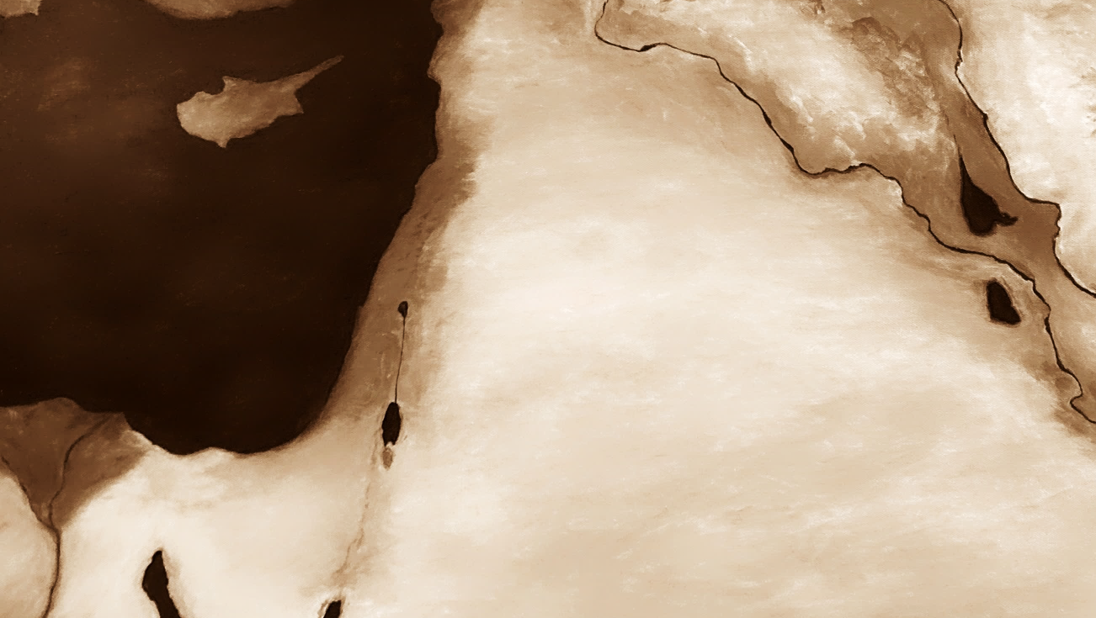

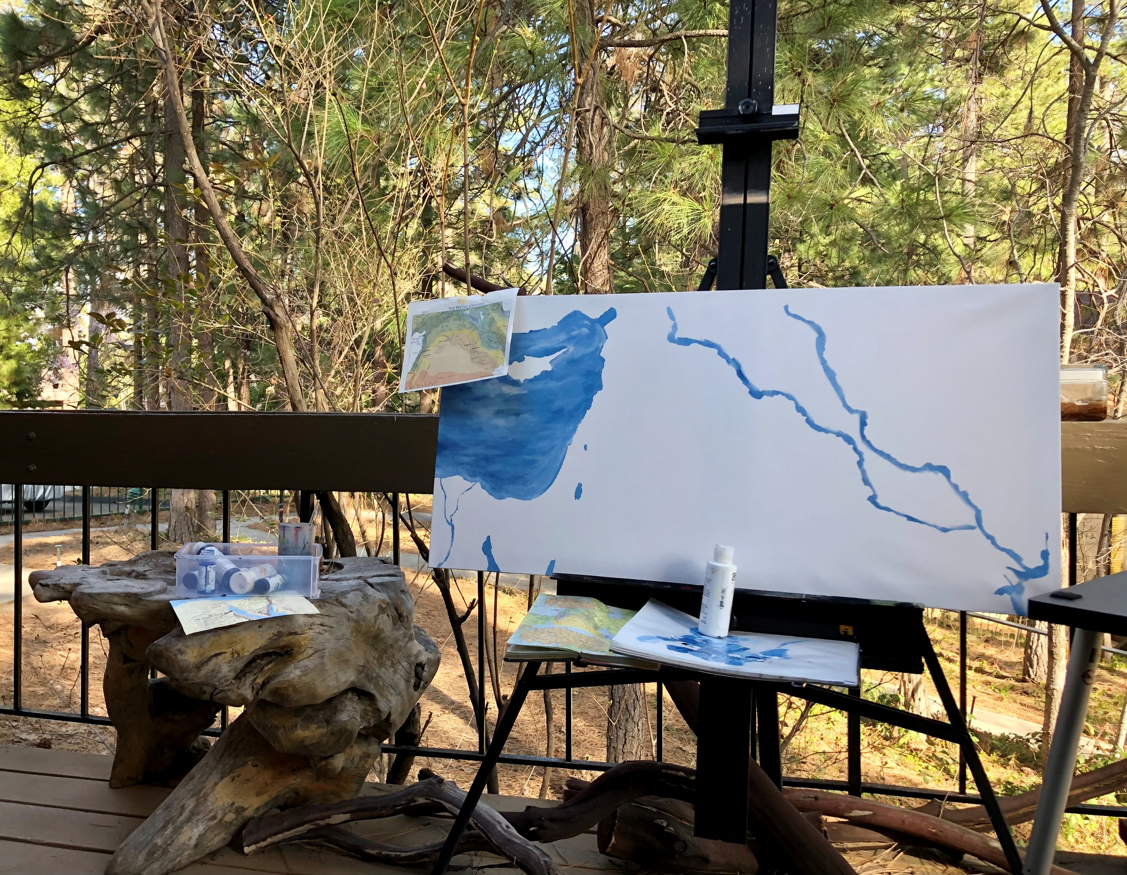
The maps on the prior pages are original works derived from original paintings we made. They’re dedicated to the public domain and are free to use and modify with no restrictions. The maps on the following pages are sourced from Picryl and are believed to be in the public domain. For more details on usage, see https://picryl.com/

Slide 9
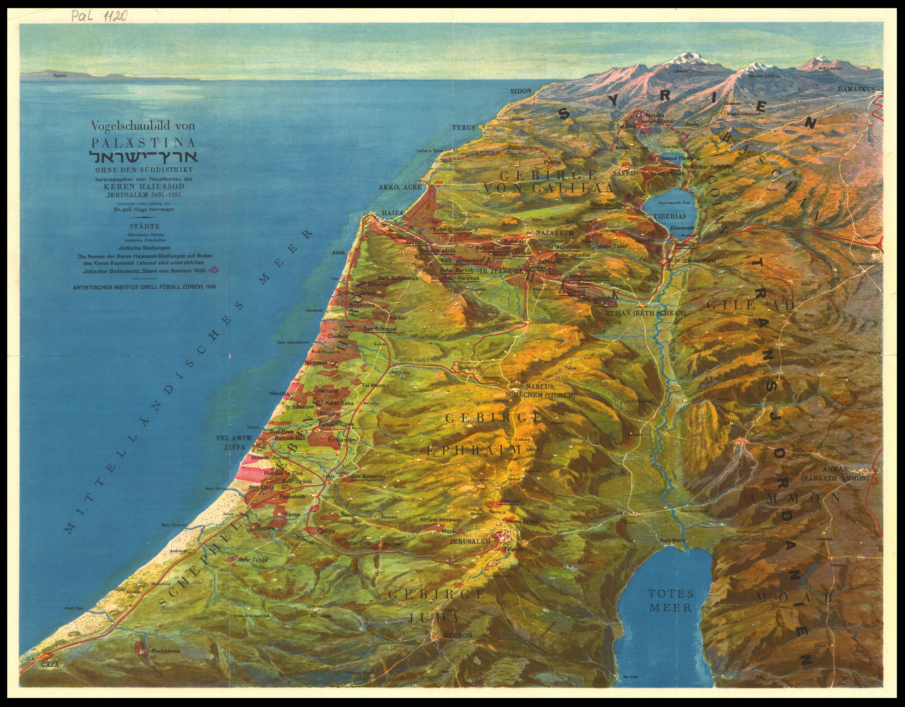

Slide 10
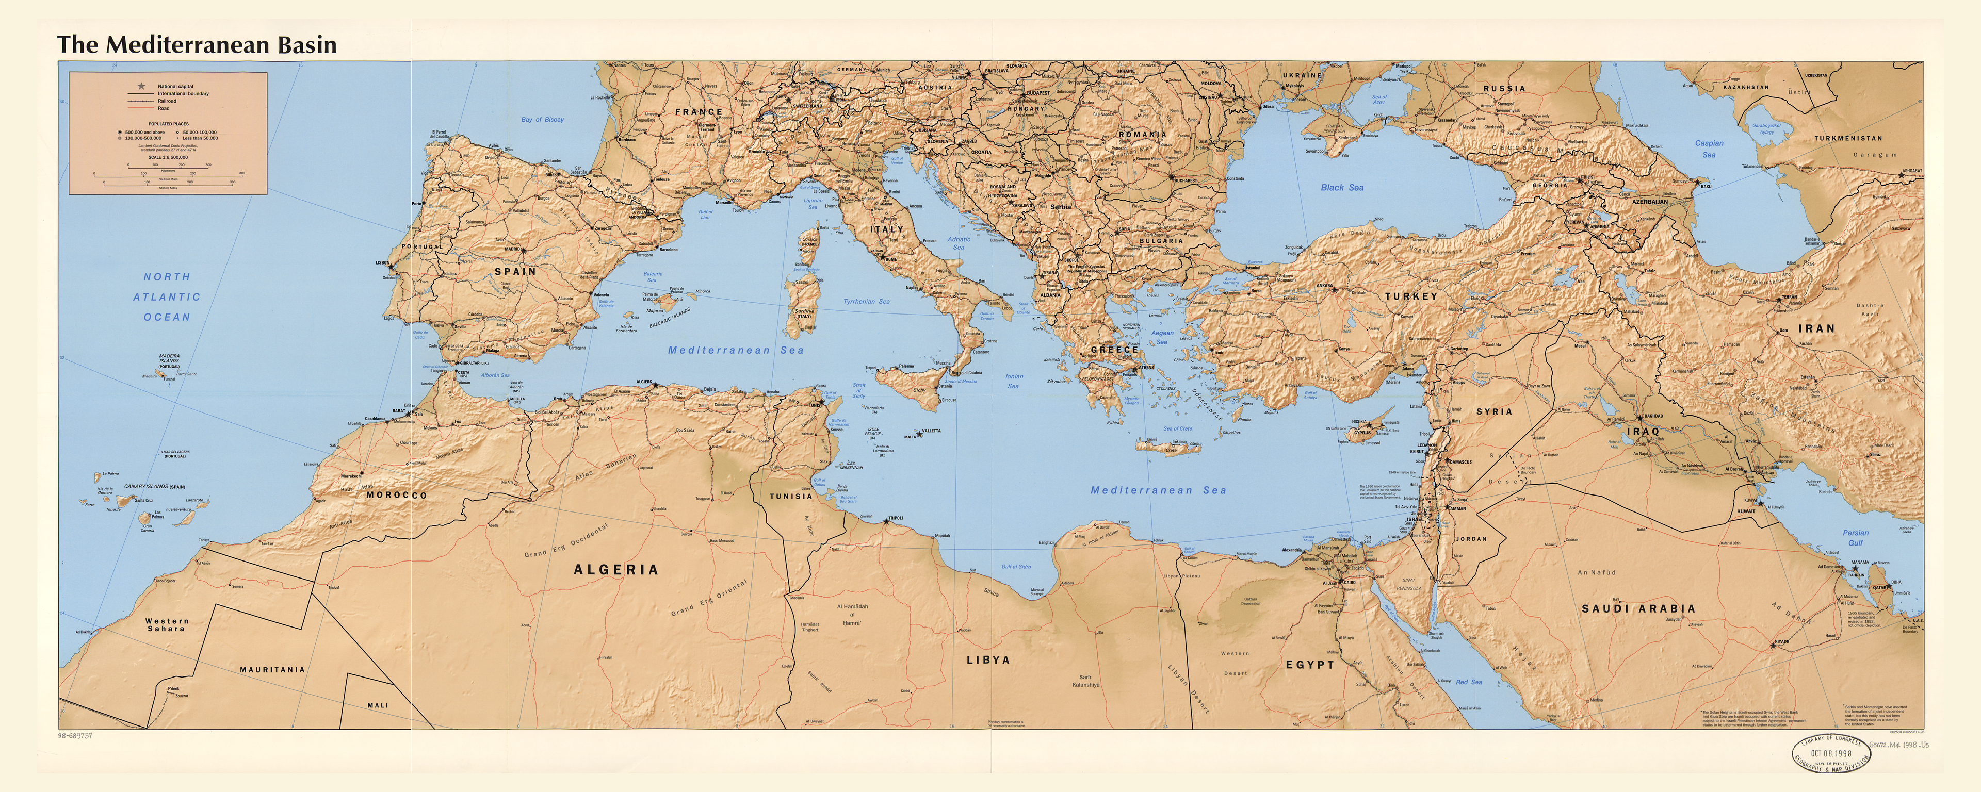

Slide 11
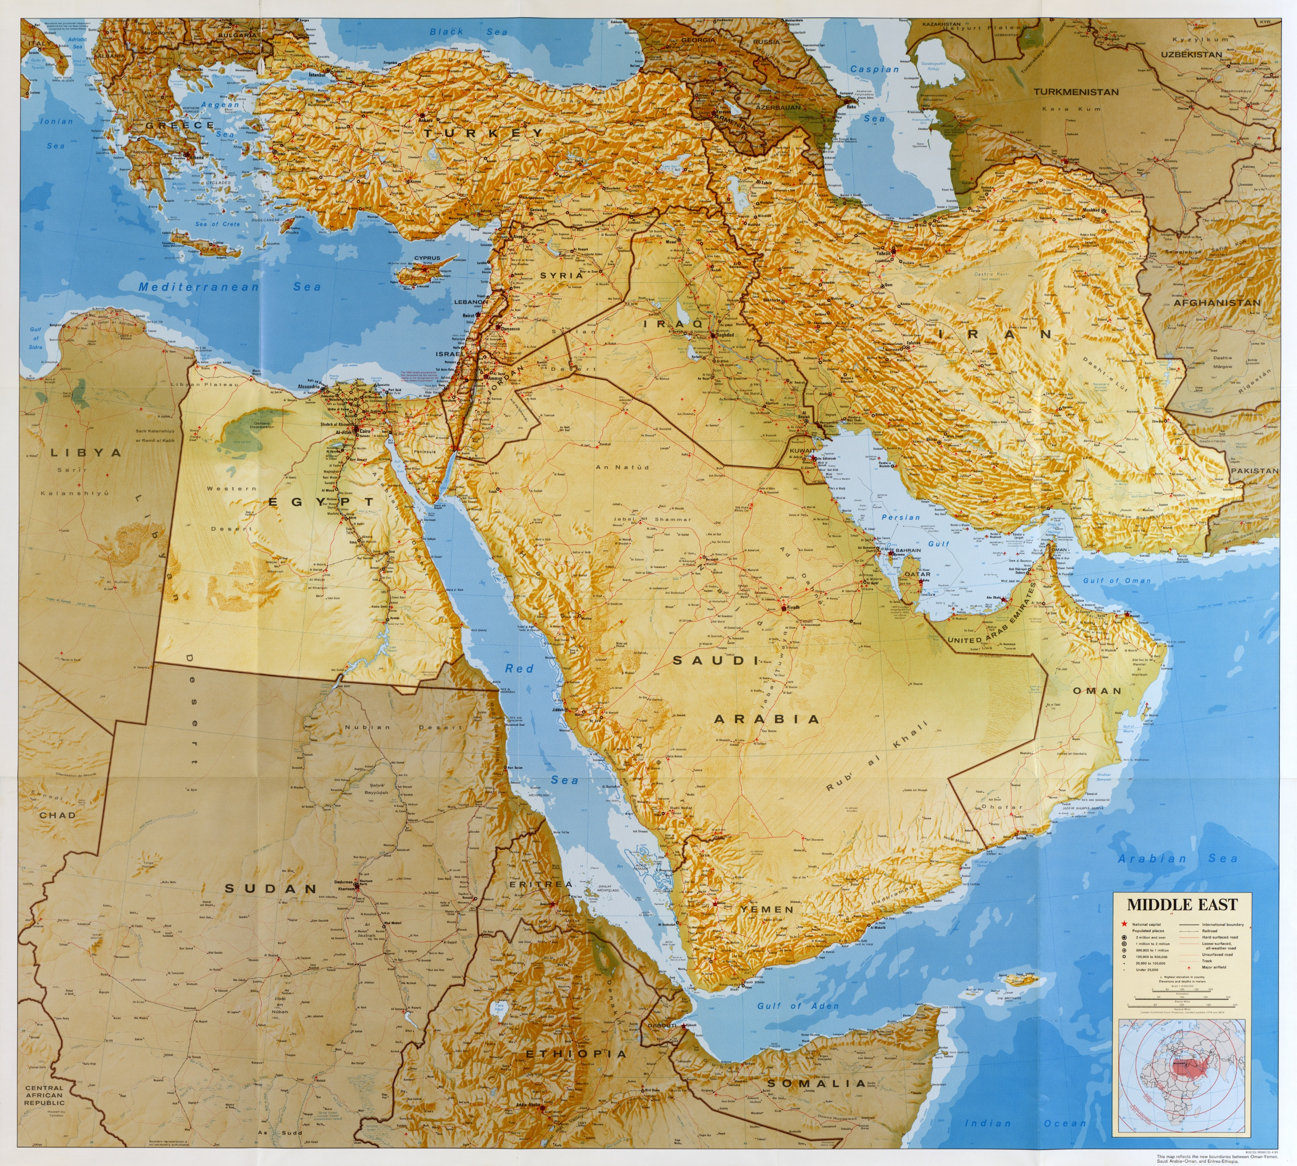

Slide 12
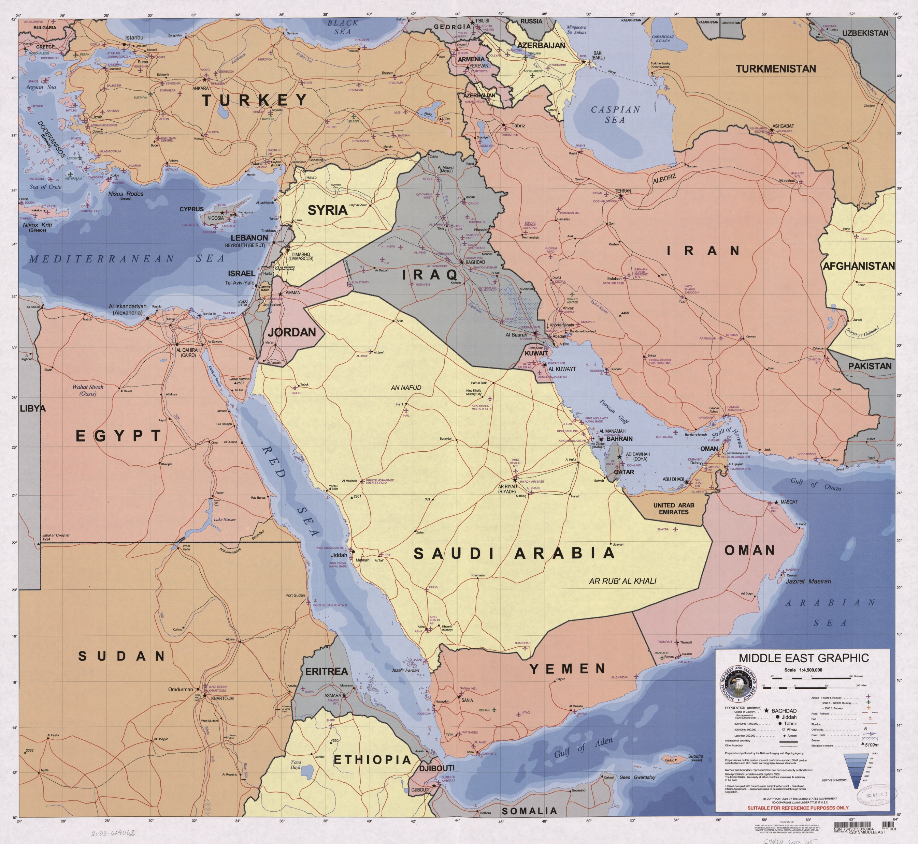

Slide 13
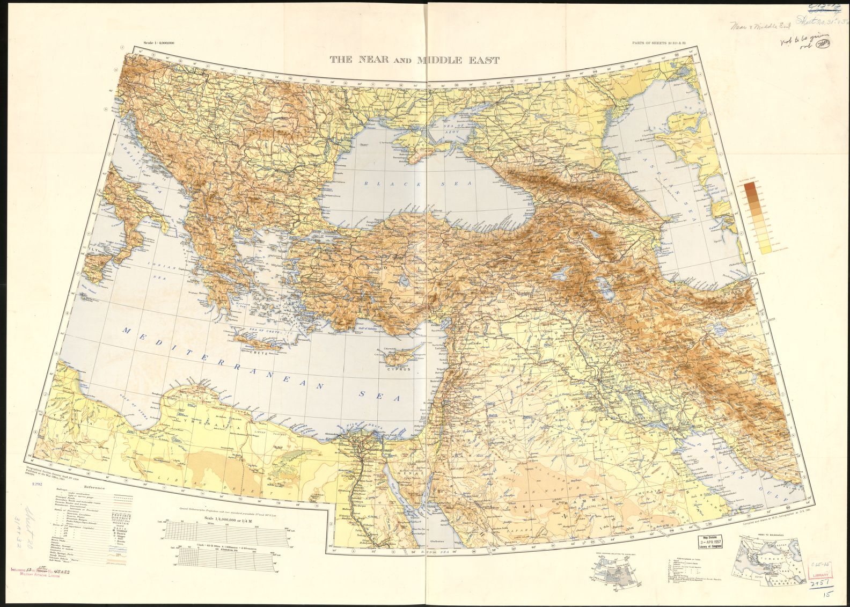
`

Slide 14
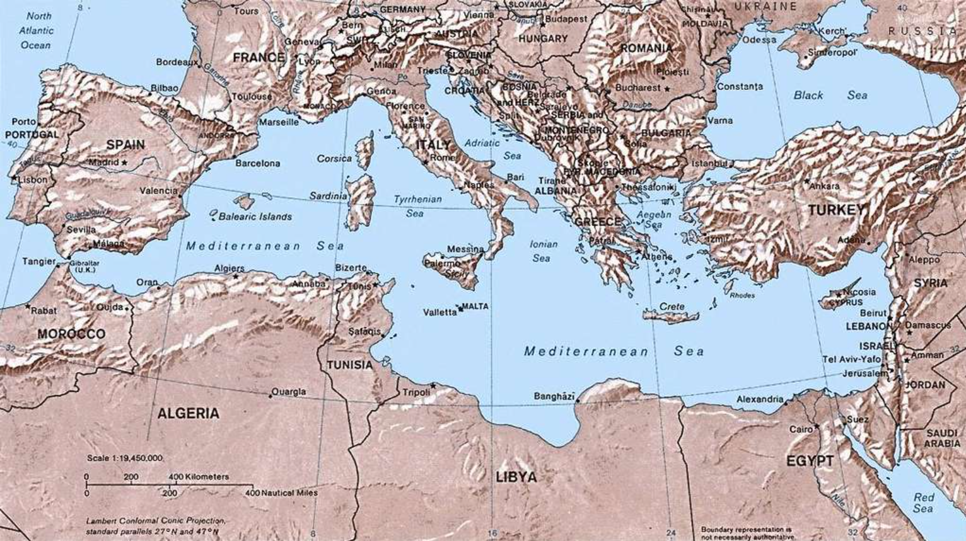

Slide 15
