Slide 1




END
TIMES TIMELINE
GENERATIONS
Presentations from Episodes 7 & 8

Slide 2


This presentation is available as a free download from fathersalphabet.com. It includes only original work and materials believed to be in the public domain. We waive all copyrights for any original work created by us. However, please note that we cannot waive or transfer any rights belonging to third parties.

Slide 3
DANIEL’S 2300 DAYS
“And it waxed great, even to the host of heaven; and it cast down some of the host and of the stars to the ground, and stamped upon them. Yea, he magnified himself even to the prince of the host, and by him the daily sacrifice was taken away, and the place of his sanctuary was cast down. “
- Daniel 8:10-11

Slide 4
DANIEL’S 2300 DAYS
“And it waxed great, even to the host of heaven; and it cast down some of the host and of the stars to the ground, and stamped upon them. Yea, he magnified himself even to the prince of the host, and by him the daily sacrifice was taken away, and the place of his sanctuary was cast down. “
- Daniel 8:10-11

Slide 5
DANIEL’S 2300 DAYS
“And it waxed great, even to the host of heaven; and it cast down some of the host and of the stars to the ground, and stamped upon them. Yea, he magnified himself even to the prince of the host, and by him the daily sacrifice was taken away, and the place of his sanctuary was cast down. “
- Daniel 8:10-11

Slide 6
DANIEL’S 2300 DAYS
“And it waxed great, even to the host of heaven; and it cast down some of the host and of the stars to the ground, and stamped upon them. Yea, he magnified himself even to the prince of the host, and by him the daily sacrifice was taken away, and the place of his sanctuary was cast down. “
רם
- Daniel 8:10-11

Slide 7

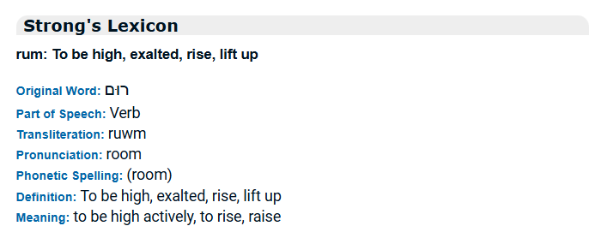
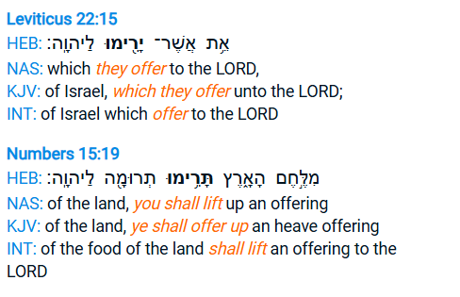

RUM
to lift up
רם
mem
(m)
resh
(r)
Original Hebrew Spelling

Slide 8
DANIEL’S 2300 DAYS
“And it waxed great, even to the host of heaven; and it cast down some of the host and of the stars to the ground, and stamped upon them. Yea, he magnified himself even to the prince of the host, and by him the daily sacrifice was taken away, and the place of his sanctuary was cast down. “
רם
- Daniel 8:10-11

Slide 9
DANIEL’S 2300 DAYS
“And an host was given him against the daily sacrifice by reason of transgression”
- Daniel 8:12

Slide 10
DANIEL’S 2300 DAYS
“And an host was given him against the daily sacrifice by reason of transgression”
- Daniel 8:12

Slide 11
DANIEL’S 2300 DAYS
“And an host was given him against the daily sacrifice by reason of transgression”
- Daniel 8:12

Slide 12
DANIEL’S 2300 DAYS
על
“And an host was given him against the daily sacrifice by reason of transgression”
- Daniel 8:12

Slide 13
DANIEL’S 2300 DAYS
על
“And an host was given him the daily sacrifice by reason of transgression and it cast down the truth to the ground; and it practised, and prospered.”
- Daniel 8:12

Slide 14
DANIEL’S 2300 DAYS
“And his power shall be mighty, but not by his own power: and he shall destroy wonderfully, and shall prosper, and practise, and shall destroy the mighty and the holy people.”
- Daniel 8:24

Slide 15
Groups at the End

Slide 16
Groups at the End
THE HOLY PEOPLE
THE NATIONS

Slide 17
Groups at the End
THE HOLY PEOPLE
THE NATIONS
Unrighteous
Arms of the antichrist
other transgressors

Slide 18
Groups at the End
THE HOLY PEOPLE
THE NATIONS
Righteous
Unrighteous
144,000
from the
12 tribes
Those hidden
in the
wilderness
Arms of the antichrist
other transgressors

Slide 19
Groups at the End
THE HOLY PEOPLE
THE NATIONS
Righteous
Unrighteous
Unrighteous
144,000
from the
12 tribes
Those hidden
in the
wilderness
Arms of the antichrist
other transgressors
Those who trample Jerusalem
other sinners

Slide 20
Groups at the End
THE HOLY PEOPLE
THE NATIONS
Righteous
Unrighteous
Righteous
Unrighteous
144,000
from the
12 tribes
Those hidden
in the
wilderness
Arms of the antichrist
other transgressors
Those hidden
in the
wilderness
Those who trample Jerusalem
other sinners

Slide 21
Groups at the End
THE HOLY PEOPLE
Righteous people from the 12 tribes of Israel
Righteous people from the nations
A NEW ISRAEL

Slide 22
Groups at the End
THE HOLY PEOPLE
Righteous people
Righteous people
A NEW ISRAEL

Slide 23
Groups at the End
THE HOLY PEOPLE
Righteous people
Righteous people
One flock, One Shepherd.
A NEW ISRAEL

Slide 24
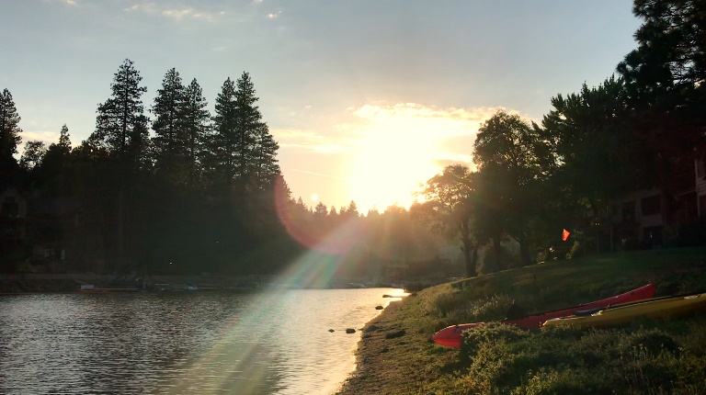
QODESH
Holy

Slide 25
QODESH
Holy
קדש
light
sun at horizon
quph
(q)
< Letter Meaning
< Picture
< Letter Name
< Sound

Slide 26
QODESH
Holy
קדש
down
door
dalet
(d)
light
sun at horizon
quph
(q)
< Letter Meaning
< Picture
< Letter Name
< Sound

Slide 27
QODESH
Holy
קדש
front
teeth
shin
(sh)
down
door
dalet
(d)
light
sun at horizon
quph
(q)
< Letter Meaning
< Picture
< Letter Name
< Sound

Slide 28
QODESH
Holy
קדש
front
teeth
shin
(sh)
down
door
dalet
(d)
light
sun at horizon
quph
(q)
< Letter Meaning
< Picture
< Letter Name
< Sound

Slide 29
TSADIQ
Righteous
קדש
light
sun at horizon
quph
(q)

Slide 30
TSADIQ
Righteous
קדש
צ ד
light
sun at horizon
quph
(q)
side
(tsad is the Hebrew
word for side)

Slide 31
“And to the woman were given two wings of a great eagle, that she might fly into the wilderness, into her place, where she is nourished for a time, and times, and half a time, from the face of the serpent.”
- Revelation 12:14

Slide 32
DANIEL’S 2300 DAYS
“Then I heard one saint speaking, and another saint said unto that certain saint which spake, How long shall be the vision concerning the daily sacrifice, and the transgression of desolation, to give both the sanctuary and the host to be trodden under foot? And he said unto me, Unto 2300 days; then shall the sanctuary be cleansed”
*literally: until evening-morning 2300, and will be made righteous (the) sanctuary
- Daniel 8:13-14

Slide 33
TIMELINE EVENT
WHAT COMES AFTER
2300 DAYS: From the time the daily sacrifice is lifted up, until the end of the trampling of the host
The Sanctuary is made righteous

Slide 34
TIMELINE EVENT
WHAT COMES AFTER
2300 DAYS: From the time the daily sacrifice is lifted up, until the end of the trampling of the host
The Sanctuary is made righteous

Slide 35
TIMELINE EVENT
WHAT COMES AFTER
2300 DAYS: From the time the daily sacrifice is lifted up, until the end of the trampling of the host
The Sanctuary is made righteous
42 MONTHS OF AUTHORITY: When antichrist wages war with the saints (i.e. the 144,000)

Slide 36
TIMELINE EVENT
WHAT COMES AFTER
2300 DAYS: From the time the daily sacrifice is lifted up, until the end of the trampling of the host
The Sanctuary is made righteous
42 MONTHS OF AUTHORITY: When antichrist wages war with the saints (i.e. the 144,000)
42 MONTHS OF TRAMPLING: When the nations trample the City of Jerusalem

Slide 37
TIMELINE EVENT
WHAT COMES AFTER
2300 DAYS: From the time the daily sacrifice is lifted up, until the end of the trampling of the host
The Sanctuary is made righteous
42 MONTHS OF AUTHORITY: When antichrist wages war with the saints (i.e. the 144,000)
42 MONTHS OF TRAMPLING: When the nations trample the City of Jerusalem
TIME, TIMES, AND HALF A TIME: When the qodesh are given into the antichrist's hand
Antichrist’s kingdom taken away; the Kingdom is given to Father’s children

Slide 38
TIMELINE EVENT
WHAT COMES AFTER
2300 DAYS: From the time the daily sacrifice is lifted up, until the end of the trampling of the host
The Sanctuary is made righteous
42 MONTHS OF AUTHORITY: When antichrist wages war with the saints (i.e. the 144,000)
42 MONTHS OF TRAMPLING: When the nations trample the City of Jerusalem
TIME, TIMES, AND HALF A TIME: When the qodesh are given into the antichrist's hand
Antichrist’s kingdom taken away; the Kingdom is given to Father’s children
TIME, TIMES, AND HALF A TIME: When the power of the holy people is scattered
All the prophecies about the antichrist are finished

Slide 39
TIMELINE EVENT
WHAT COMES AFTER
2300 DAYS: From the time the daily sacrifice is lifted up, until the end of the trampling of the host
The Sanctuary is made righteous
42 MONTHS OF AUTHORITY: When antichrist wages war with the saints (i.e. the 144,000)
42 MONTHS OF TRAMPLING: When the nations trample the City of Jerusalem
TIME, TIMES, AND HALF A TIME: When the qodesh are given into the antichrist's hand
Antichrist’s kingdom taken away; the Kingdom is given to Father’s children
TIME, TIMES, AND HALF A TIME: When the power of the holy people is scattered
All the prophecies about the antichrist are finished
1290 DAYS: The number of days left from the time the daily sacrifice is stopped and the abomination of desolation is set up
No more days

Slide 40
TIMELINE EVENT
WHAT COMES AFTER
2300 DAYS: From the time the daily sacrifice is lifted up, until the end of the trampling of the host
The Sanctuary is made righteous
42 MONTHS OF AUTHORITY: When antichrist wages war with the saints (i.e. the 144,000)
42 MONTHS OF TRAMPLING: When the nations trample the City of Jerusalem
TIME, TIMES, AND HALF A TIME: When the qodesh are given into the antichrist's hand
Antichrist’s kingdom taken away; the Kingdom is given to Father’s children
TIME, TIMES, AND HALF A TIME: When the power of the holy people is scattered
All the prophecies about the antichrist are finished
1290 DAYS: The number of days left from the time the daily sacrifice is stopped and the abomination of desolation is set up
No more days
1335 DAYS: Blessed is he who waits and comes to these days
Resurrection of the dead, Daniel stands for his inheritance

Slide 41
TIMELINE EVENT
2300 DAYS: From the time the daily sacrifice is lifted up, until the end of the trampling of the host
42 MONTHS OF AUTHORITY: When antichrist wages war with the saints (i.e. the 144,000)
42 MONTHS OF TRAMPLING: When the nations trample the City of Jerusalem
E N D O F S U M M E R
TIME, TIMES, AND HALF A TIME: When the qodesh are given into the antichrist's hand
TIME, TIMES, AND HALF A TIME: When the power of the holy people is scattered
1290 DAYS: The number of days left from the time the daily sacrifice is stopped and the abomination of desolation is set up
1335 DAYS: Blessed is he who waits and comes to these days

Slide 42
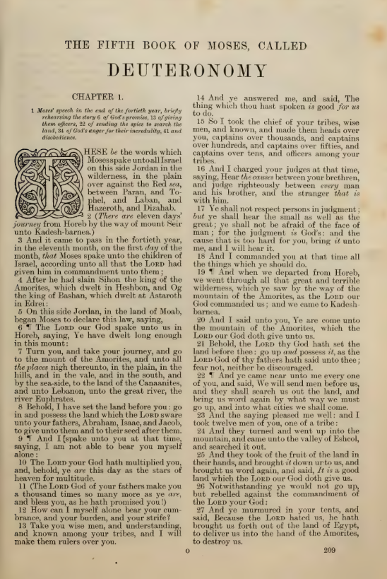

Slide 44
REVELATION’S 42 MONTHS
“And there was given unto him a mouth speaking great things and blasphemies; and power was given unto him to continue 42 months…
And it was given unto him to make war with the saints, and to overcome them: and power was given him over all kindreds, and tongues, and nations. And all that dwell upon the earth shall worship him, whose names are not written in the book of life of the Lamb slain from the foundation of the world.”
From Revelation 13:

Slide 45
REVELATION’S 42 MONTHS
“And there was given unto him a mouth speaking great things and blasphemies; and power was given unto him to continue 42 months…
And it was given unto him to make war with the saints, and to overcome them: and power was given him over all kindreds, and tongues, and nations. And all that dwell upon the earth shall worship him, whose names are not written in the book of life of the Lamb slain from the foundation of the world.”
From Revelation 13:
“And the dragon was wroth with the woman, and went to make war with the remnant of her seed, which keep the commandments of GOD, and have the testimony of JESUS CHRIST.”
From Revelation 12:

Slide 46
DANIEL’S TIME, TIMES AND HALF A TIME (#1)
“And he shall speak great words against the most High, and shall wear out the saints of the most High, and think to change times and laws: and they shall be given into his hand until a time and times and the dividing of time.”
- Daniel 7:25

Slide 47
THE RIGHTEOUS ARE PROTECTED IN THE WILDERNESS
“And to the woman were given two wings of a great eagle, that she might fly into the wilderness, into her place, where she is nourished for a time, and times, and half a time, from the face of the serpent.
And the serpent cast out of his mouth water as a flood after the woman, that he might cause her to be carried away of the flood.
And the earth helped the woman, and the earth opened her mouth, and swallowed up the flood which the dragon cast out of his mouth.”
- Revelation 12:14-16

Slide 48
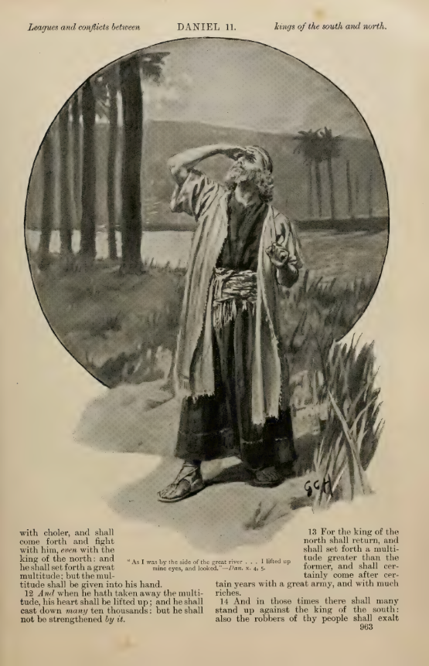
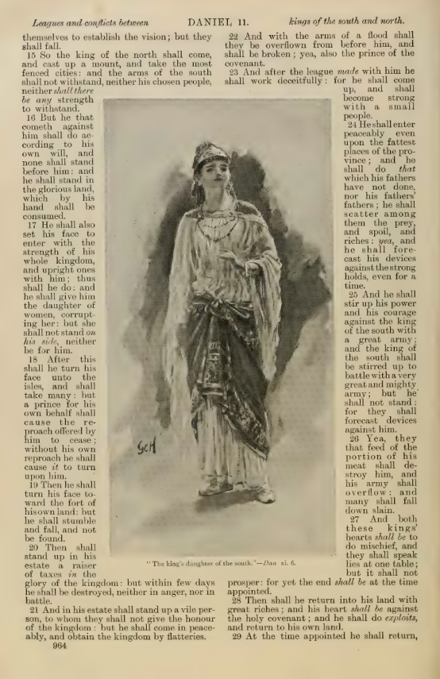
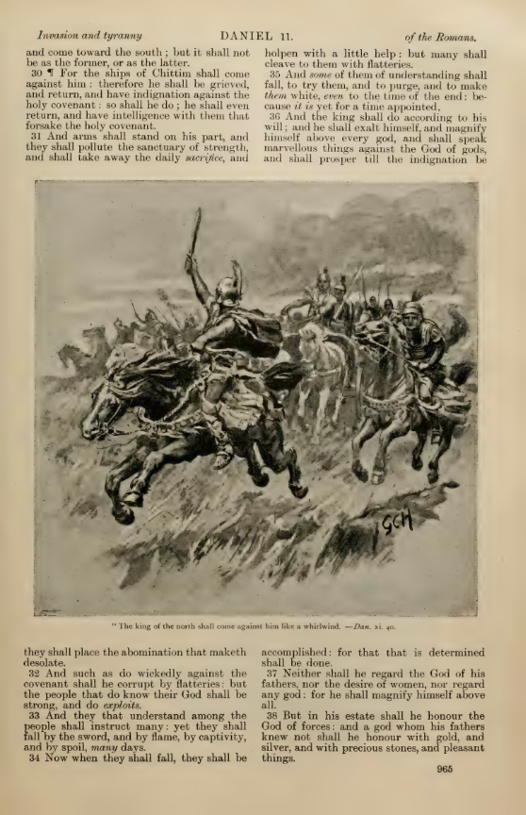
DANIEL 11: THE KINGS OF THE NORTH AND SOUTH

Slide 49
THE ABOMINATION OF DESOLATION IN REVELATION
“And he had power to give life unto the image of the beast, that the image of the beast should both speak, and cause that as many as would not worship the image of the beast should be killed.”
- Revelation 13

Slide 50
DANIEL’S TIME, TIMES AND HALF A TIME (#2)
“Forces from him shall appear and profane the temple and fortress, and shall take away the regular burnt offering. And they shall set up the abomination that makes desolate.”
- Daniel 11:31

Slide 51
DANIEL’S TIME, TIMES AND HALF A TIME (#2)
“And the king shall do according to his will; and he shall exalt himself, and magnify himself above every god, and shall speak marvellous things against the GOD of gods, and shall prosper till the indignation be accomplished: for that that is determined shall be done.”
- Daniel 11:36

Slide 52
DANIEL’S TIME, TIMES AND HALF A TIME (#2)
From Daniel 12:
‘How long shall it be to the end of these wonders?’
And I heard the man clothed in linen, which was upon the waters of the river, when he held up his right hand and his left hand unto heaven, and sware by him that liveth for ever that it shall be for a time, times, and an half; and when he shall have accomplished to scatter the power of the holy people, all these things shall be finished.”

Slide 53
DANIEL’S TIME, TIMES AND HALF A TIME (#2)
‘How long shall it be to the end of these wonders?’
And I heard the man clothed in linen, which was upon the waters of the river, when he held up his right hand and his left hand unto heaven, and sware by him that liveth for ever that it shall be for a time, times, and an half; and when he shall have accomplished to scatter the power of the holy people, all these things shall be finished.”
From Daniel 12:

Slide 54
DANIEL’S TIME, TIMES AND HALF A TIME (#2)
‘How long shall it be to the end of these wonders?’
And I heard the man clothed in linen, which was upon the waters of the river, when he held up his right hand and his left hand unto heaven, and sware by him that liveth for ever that it shall be for a time, times, and an half; and when he shall have accomplished to scatter the power of the holy people, all these things shall be finished.”
From Daniel 12:
“For the LORD will vindicate his people and have compassion on his servants, when he sees that their power is gone and there is none remaining, bond or free.”
From the
Song of Moses
(Deut. 32):

Slide 55
DANIEL’S 1290 DAYS
“O my Lord, what shall be the end of these things? And he said, Go thy way, Daniel: for the words are closed up and sealed till the time of the end. Many shall be purified, and made white, and tried; but the wicked shall do wickedly: and none of the wicked shall understand; but the wise shall understand.
And from the time that the daily sacrifice shall be taken away, and the abomination that maketh desolate set up, there shall be 1290 days.”
- Daniel 12:8-11

Slide 56
DANIEL’S 1290 DAYS
“O my Lord, what shall be the end of these things? And he said, Go thy way, Daniel: for the words are closed up and sealed till the time of the end. Many shall be purified, and made white, and tried; but the wicked shall do wickedly: and none of the wicked shall understand; but the wise shall understand.
And from the time that the daily sacrifice shall be taken away, and the abomination that maketh desolate set up, there shall be 1290 days.”
- Daniel 12:8-11

Slide 57
DANIEL’S 1335 DAYS
“Blessed is he that waiteth, and cometh to the 1335 days.”
- Daniel 12

Slide 58
DANIEL’S 1335 DAYS
“Blessed is he that waiteth, and cometh to the 1335 days.
But go thou thy way till the end be: for thou shalt rest, and stand in thy lot at the end of the days.”
- Daniel 12

Slide 59
“Blessed is he that waiteth, and cometh to the 1335 days.”

Slide 60
“Blessed is he that waiteth, and cometh to the 1335 days.”
“Therefore wait ye upon me, saith THE LORD
until the day that I rise up to the prey: for My determination is to gather the nations, that I may assemble the kingdoms, to pour upon them Mine indignation (zaam), even all My fierce anger: for all the earth shall be devoured with the fire of My jealousy.”
- Zephaniah 3

Slide 61
“Blessed is he that waiteth, and cometh to the 1335 days.”
“Therefore wait ye upon me, saith THE LORD…
[Zephaniah 3]
1335 days
His Final Wrath
(Zaam)
…until the day that I rise up to the prey: for My determination is to gather the nations, that I may assemble the kingdoms, to pour upon them Mine indignation (zaam), even all My fierce anger: for all the earth shall be devoured with the fire of My jealousy.”

Slide 62
“Blessed is he that waiteth, and cometh to the 1335 days.”
“Therefore wait ye upon me, saith THE LORD…
[Zephaniah 3]
We will be hidden
through
1335 days
His Final Wrath
(Zaam)

Slide 63
“Blessed is he that waiteth, and cometh to the 1335 days.”
“Therefore wait ye upon me, saith THE LORD…
[Zephaniah 3]
We will be hidden
through
1335 days
His Final Wrath
(Zaam)
You’re blessed to live through this entire time period

Slide 64
“Blessed is he that waiteth, and cometh to the 1335 days.”
“Therefore wait ye upon me, saith THE LORD…
[Zephaniah 3]
We will be hidden
through
1335 days
His Final Wrath
(Zaam)
You’re blessed to live through this entire time period
“Behold, at that time I will undo all that afflict thee… and I will gather her that was driven out”

Slide 65
“Blessed is he that waiteth, and cometh to the 1335 days.”
“Therefore wait ye upon me, saith THE LORD…
[Zephaniah 3]
We will be hidden
through
1335 days
His Final Wrath
(Zaam)
You’re blessed to live through this entire time period
“Behold, at that time I will undo all that afflict thee… and I will gather her that was driven out”
“I will gather them that are sorrowful for the solemn assembly (moed)”

Slide 66
“Blessed is he that waiteth, and cometh to the 1335 days.”
“Therefore wait ye upon me, saith THE LORD…
[Zephaniah 3]
We will be hidden
through
1335 days
His Final Wrath
(Zaam)
You’re blessed to live through this entire time period
“Behold, at that time I will undo all that afflict thee… and I will gather her that was driven out”
“I will gather them that are sorrowful for the solemn assembly (moed)”
“At that time will I bring you again, even in the time that I gather you: for I will make you a name and a praise among all people of the earth, when I turn back your captivity before your eyes, saith THE LORD.”

Slide 67
“Blessed is he that waiteth, and cometh to the 1335 days.”
“Therefore wait ye upon me, saith THE LORD…
[Zephaniah 3]
We will be hidden
through
1335 days
His Final Wrath
(Zaam)
You’re blessed to live through this entire time period
The second exodus:
when he gathers the israel of god including the lost tribes, the dispersed of Judah, and all those from the nations who are in YASHUA.
One Flock with One shepherd, who will be nourished in the wilderness.

Slide 68
IS SUMMER THE END?
Yom Teruah – a type and shadow of YASHUA’s return – is the day after summer
Summer is likened to the End in the Fig Tree Parable (Mark 13)
Harvest is the end of the world (Matt. 13, Rev. 14)
Harvest needs to be finished by the end of summer in order to celebrate the Feast of Tabernacles 15 days after summer’s end (Leviticus 23:39)
Enoch said all fruits are gathered in by the last day of summer
2300 days alignment
The days of tribulation will be cut short (Matthew 24:22)

Slide 69
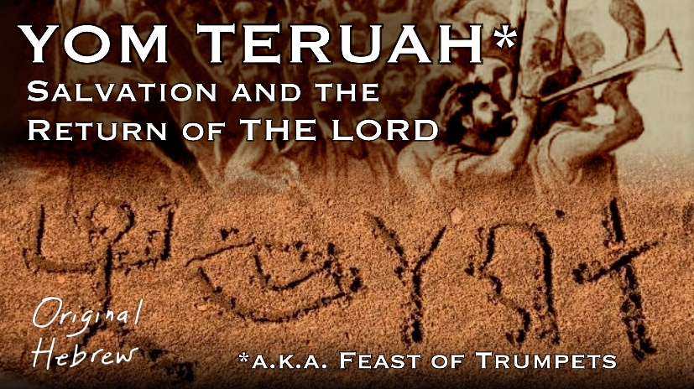
IS SUMMER THE END?
Yom Teruah – a type and shadow of YASHUA’s return – is the day after summer
Summer is likened to the End in the Fig Tree Parable (Mark 13)
Harvest is the end of the world (Matt. 13, Rev. 14)
Harvest needs to be finished by the end of summer in order to celebrate the Feast of Tabernacles 15 days after summer’s end (Leviticus 23:39)
Enoch said all fruits are gathered in by the last day of summer
2300 days alignment
The days of tribulation will be cut short (Matthew 24:22)

Slide 70
IS SUMMER THE END?
Yom Teruah – a type and shadow of YASHUA’s return – is the day after summer
Summer is likened to the End in the Fig Tree Parable (Mark 13)
Harvest is the end of the world (Matt. 13, Rev. 14)
Harvest needs to be finished by the end of summer in order to celebrate the Feast of Tabernacles 15 days after summer’s end (Leviticus 23:39)
Enoch said all fruits are gathered in by the last day of summer
2300 days alignment
The days of tribulation will be cut short (Matthew 24:22)

Slide 71
IS SUMMER THE END?
“From the fig tree learn its lesson: as soon as its branch becomes tender and puts out its leaves, you know that summer is near.
So also, when you see these things taking place, you know that he [THE SON OF MAN] is near, at the very gates.” – Mark 13
Yom Teruah – a type and shadow of YASHUA’s return – is the day after summer
Summer is likened to the End in the Fig Tree Parable (Mark 13)
Harvest is the end of the world (Matt. 13, Rev. 14)
Harvest needs to be finished by the end of summer in order to celebrate the Feast of Tabernacles 15 days after summer’s end (Leviticus 23:39)
Enoch said all fruits are gathered in by the last day of summer
2300 days alignment
The days of tribulation will be cut short (Matthew 24:22)

Slide 72
IS SUMMER THE END?
Yom Teruah – a type and shadow of YASHUA’s return – is the day after summer
Summer is likened to the End in the Fig Tree Parable (Mark 13)
Harvest is the end of the world (Matt. 13, Rev. 14)
Harvest needs to be finished by the end of summer in order to celebrate the Feast of Tabernacles 15 days after summer’s end (Leviticus 23:39)
Enoch said all fruits are gathered in by the last day of summer
2300 days alignment
The days of tribulation will be cut short (Matthew 24:22)

Slide 73
IS SUMMER THE END?
Yom Teruah – a type and shadow of YASHUA’s return – is the day after summer
Summer is likened to the End in the Fig Tree Parable (Mark 13)
Harvest is the end of the world (Matt. 13, Rev. 14)
Harvest needs to be finished by the end of summer in order to celebrate the Feast of Tabernacles 15 days after summer’s end (Leviticus 23:39)
Enoch said all fruits are gathered in by the last day of summer
2300 days alignment
The days of tribulation will be cut short (Matthew 24:22)

Slide 74
IS SUMMER THE END?
Yom Teruah – a type and shadow of YASHUA’s return – is the day after summer
Summer is likened to the End in the Fig Tree Parable (Mark 13)
Harvest is the end of the world (Matt. 13, Rev. 14)
Harvest needs to be finished by the end of summer in order to celebrate the Feast of Tabernacles 15 days after summer’s end (Leviticus 23:39)
Enoch said all fruits are gathered in by the last day of summer
2300 days alignment
The days of tribulation will be cut short (Matthew 24:22)

Slide 75
IS SUMMER THE END?
Yom Teruah – a type and shadow of YASHUA’s return – is the day after summer
Summer is likened to the End in the Fig Tree Parable (Mark 13)
Harvest is the end of the world (Matt. 13, Rev. 14)
Harvest needs to be finished by the end of summer in order to celebrate the Feast of Tabernacles 15 days after summer’s end (Leviticus 23:39)
Enoch said all fruits are gathered in by the last day of summer
2300 days alignment
The days of tribulation will be cut short (Matthew 24:22)

Slide 76
IS SUMMER THE END?
Yom Teruah – a type and shadow of YASHUA’s return – is the day after summer
Summer is likened to the End in the Fig Tree Parable (Mark 13)
Harvest is the end of the world (Matt. 13, Rev. 14)
Harvest needs to be finished by the end of summer in order to celebrate the Feast of Tabernacles 15 days after summer’s end (Leviticus 23:39)
Enoch said all fruits are gathered in by the last day of summer
2300 days alignment
The days of tribulation will be cut short (Matthew 24:22)

Slide 77
2300 days

Slide 78
2300 days in father’s 364 day year calendar
YEAR 1
SHAVUOT
YEAR 2
YEAR 3
YEAR 4
YEAR 5
YEAR 6
YEAR 7
YOM
TERUAH

Slide 79
IS SUMMER THE END?
Yom Teruah – a type and shadow of YASHUA’s return – is the day after summer
Summer is likened to the End in the Fig Tree Parable (Mark 13)
Harvest is the end of the world (Matt. 13, Rev. 14)
Harvest needs to be finished by the end of summer in order to celebrate the Feast of Tabernacles 15 days after summer’s end (Leviticus 23:39)
Enoch said all fruits are gathered in by the last day of summer
2300 days alignment
The days of tribulation will be cut short (Matthew 24:22)

Slide 80
IS SUMMER THE END?
Yom Teruah – a type and shadow of YASHUA’s return – is the day after summer
Summer is likened to the End in the Fig Tree Parable (Mark 13)
Harvest is the end of the world (Matt. 13, Rev. 14)
Harvest needs to be finished by the end of summer in order to celebrate the Feast of Tabernacles 15 days after summer’s end (Leviticus 23:39)
Enoch said all fruits are gathered in by the last day of summer
2300 days alignment
The days of tribulation will be cut short (Matthew 24:22)

Slide 81

THE DAY OF THE LORD
  Starts with His wrath
  Ends with Him creating the new heavens and new earth
  A day with THE LORD is as 1,000 years (a millenium)
  The Day of THE LORD is day of Teruah (Zephaniah 1:14-16)
  We won’t know the day or the hour
    “the light shall not be clear, nor dark: But it shall be one day which shall be known to THE LORD, not day, nor night…” Zechariah 14:6-7
    “The sun will be darkened, and the moon will not give its light” Matthew 24:29

Slide 82
DANIEL’S 70 WEEKS PROPHECY

Slide 83
DANIEL’S 70 WEEKS PROPHECY
Daniel’s 70 Weeks

Slide 84
DANIEL’S 70 WEEKS PROPHECY
Daniel’s 70 Weeks
7 weeks
(49 years)
62 weeks
(434 years)
1 week
(7 years)

Slide 85
DANIEL’S 70 WEEKS PROPHECY
Daniel’s 70 Weeks
7 weeks
(49 years)
62 weeks
(434 years)
1 week
(7 years)
YASHUA was crucified on Aviv 14 in the final week.

Slide 86

Daniel’s Final Week (7 Years): A Week of Righteousness

Slide 87
Daniel’s Final Week (7 Years): A Week of Righteousness
Year 1 | Year 2 | Year 3 | Year 4 | Year 5 | Year 6 | Year 7

Slide 88
End Times Timeline
(A Possible Scenario)
Daniel’s Final Week (7 Years): A Week of Righteousness
Year 1 | Year 2 | Year 3 | Year 4 | Year 5 | Year 6 | Year 7

Slide 89
End Times Timeline
(A Possible Scenario)
Daniel’s Final Week (7 Years): A Week of Righteousness
Year 1 | Year 2 | Year 3 | Year 4 | Year 5 | Year 6 | Year 7
YASHUA already fulfilled the first 14 days of Daniel’s final week.

Slide 90
End Times Timeline
(A Possible Scenario)
The final week of Daniel’s
70 Weeks prophecy resumes on Aviv 15.
This is the last 7 years of the age.
Year 1, 15th day of the 1st month.
Daniel’s Final Week (7 Years): A Week of Righteousness
Year 1 | Year 2 | Year 3 | Year 4 | Year 5 | Year 6 | Year 7

Slide 91
End Times Timeline
(A Possible Scenario)
The final week of Daniel’s
70 Weeks prophecy resumes on Aviv 15.
This is the last 7 years of the age.
Year 1, 15th day of the 1st month.
Daniel’s Final Week (7 Years): A Week of Righteousness
Year 1 | Year 2 | Year 3 | Year 4 | Year 5 | Year 6 | Year 7
2300 Days begins with
the daily sacrifice being
lifted up.
Year 1, 7th day of the 3rd month.

Slide 92
End Times Timeline
(A Possible Scenario)
The final week of Daniel’s
70 Weeks prophecy resumes on Aviv 15.
This is the last 7 years of the age.
Year 1, 15th day of the 1st month.
Daniel’s Final Week (7 Years): A Week of Righteousness
Year 1 | Year 2 | Year 3 | Year 4 | Year 5 | Year 6 | Year 7
2300 Days begins with
the daily sacrifice being
lifted up.
Year 1, 7th day of the 3rd month.
1335 Days begins. Possible start of the Second Exodus.
Year 3, 1st day of the 11th month.

Slide 93
End Times Timeline
(A Possible Scenario)
1290 Days begins with the stopping of the daily
sacrifice. Year 3, 16th day of the 12th month.
The abomination of desolation is set up sometime
within the next two weeks.
The final week of Daniel’s
70 Weeks prophecy resumes on Aviv 15.
This is the last 7 years of the age.
Year 1, 15th day of the 1st month.
Daniel’s Final Week (7 Years): A Week of Righteousness
Year 1 | Year 2 | Year 3 | Year 4 | Year 5 | Year 6 | Year 7
2300 Days begins with
the daily sacrifice being
lifted up.
Year 1, 7th day of the 3rd month.
1335 Days begins. Possible start of the Second Exodus.
Year 3, 1st day of the 11th month.

Slide 94
End Times Timeline
(A Possible Scenario)
1290 Days begins with the stopping of the daily
sacrifice. Year 3, 16th day of the 12th month.
The abomination of desolation is set up sometime
within the next two weeks.
The final week of Daniel’s
70 Weeks prophecy resumes on Aviv 15.
This is the last 7 years of the age.
Year 1, 15th day of the 1st month.
42 months of antichrist’s authority begins.
During this same time, the nations trample the city, the 144,000 will be persecuted, and the Two Witnesses begin prophesying for 1260 days.
Year 4, 1st day of the 1st month.
Sometime in the next 6 months, the church is pursued and delivered before reaching the place GOD has prepared for us in the wilderness.
Daniel’s Final Week (7 Years): A Week of Righteousness
Year 1 | Year 2 | Year 3 | Year 4 | Year 5 | Year 6 | Year 7
2300 Days begins with
the daily sacrifice being
lifted up.
Year 1, 7th day of the 3rd month.
1335 Days begins. Possible start of the Second Exodus.
Year 3, 1st day of the 11th month.

Slide 95
End Times Timeline
(A Possible Scenario)
1290 Days begins with the stopping of the daily
sacrifice. Year 3, 16th day of the 12th month.
The abomination of desolation is set up sometime
within the next two weeks.
The final week of Daniel’s
70 Weeks prophecy resumes on Aviv 15.
This is the last 7 years of the age.
Year 1, 15th day of the 1st month.
42 months of antichrist’s authority begins.
During this same time, the nations trample the city, the 144,000 will be persecuted, and the Two Witnesses begin prophesying for 1260 days.
Year 4, 1st day of the 1st month.
Sometime in the next 6 months, the church is pursued and delivered before reaching the place GOD has prepared for us in the wilderness.
Daniel’s Final Week (7 Years): A Week of Righteousness
Year 1 | Year 2 | Year 3 | Year 4 | Year 5 | Year 6 | Year 7
2300 Days begins with
the daily sacrifice being
lifted up.
Year 1, 7th day of the 3rd month.
We reach our place in the wilderness
where we’re nourished for a time,
times, and half a time.
Year 4, 1st day of the 7th month.
1335 Days begins. Possible start of the Second Exodus.
Year 3, 1st day of the 11th month.

Slide 96
End Times Timeline
(A Possible Scenario)
1290 Days begins with the stopping of the daily
sacrifice. Year 3, 16th day of the 12th month.
The abomination of desolation is set up sometime
within the next two weeks.
The final week of Daniel’s
70 Weeks prophecy resumes on Aviv 15.
This is the last 7 years of the age.
Year 1, 15th day of the 1st month.
42 months of antichrist’s authority begins.
During this same time, the nations trample the city, the 144,000 will be persecuted, and the Two Witnesses begin prophesying for 1260 days.
Year 4, 1st day of the 1st month.
Sometime in the next 6 months, the church is pursued and delivered before reaching the place GOD has prepared for us in the wilderness.
Daniel’s Final Week (7 Years): A Week of Righteousness
Year 1 | Year 2 | Year 3 | Year 4 | Year 5 | Year 6 | Year 7
2300 Days begins with
the daily sacrifice being
lifted up.
Year 1, 7th day of the 3rd month.
We reach our place in the wilderness
where we’re nourished for a time,
times, and half a time.
Year 4, 1st day of the 7th month.
1335 Days begins. Possible start of the Second Exodus.
Year 3, 1st day of the 11th month.
The Two Witnesses are killed.
There are 14 days left.
Year 7, 17th day of the 6th month.

Slide 97
End Times Timeline
(A Possible Scenario)
The days are cut short.
Antichrist’s authority ends,
and the power of Israel is
now scattered. The 1290,
2300 and 1335 days are
completed. GOD’s final zaam
(wrath) begins, we are hidden,
and it is now the Day of THE
LORD – “one day known to
Him, not day nor night”
(Zeph 14:7, Mt 24:29).
It starts on Yom Teruah.
Year 7, 1st day of the 7th month.
1290 Days begins with the stopping of the daily
sacrifice. Year 3, 16th day of the 12th month.
The abomination of desolation is set up sometime
within the next two weeks.
The final week of Daniel’s
70 Weeks prophecy resumes on Aviv 15.
This is the last 7 years of the age.
Year 1, 15th day of the 1st month.
42 months of antichrist’s authority begins.
During this same time, the nations trample the city, the 144,000 will be persecuted, and the Two Witnesses begin prophesying for 1260 days.
Year 4, 1st day of the 1st month.
Sometime in the next 6 months, the church is pursued and delivered before reaching the place GOD has prepared for us in the wilderness.
Daniel’s Final Week (7 Years): A Week of Righteousness
From here on, the Sanctuary
is being made righteous, the
kingdom is given to His people,
and Daniel and all who are His
and have slept arise to their
inheritance. All men will look
to the path of uprightness and
all dominions will serve Him.
The Day of THE LORD is
as 1000 years (a Millenium),
and this is just the beginning.
Glory to HIS NAME.
Year 1 | Year 2 | Year 3 | Year 4 | Year 5 | Year 6 | Year 7
2300 Days begins with
the daily sacrifice being
lifted up.
Year 1, 7th day of the 3rd month.
We reach our place in the wilderness
where we’re nourished for a time,
times, and half a time.
Year 4, 1st day of the 7th month.
1335 Days begins. Possible start of the Second Exodus.
Year 3, 1st day of the 11th month.
The Two Witnesses are killed.
There are 14 days left.
Year 7, 17th day of the 6th month.

Slide 98
father’s 364 day year
34 AD
Resurrection
March
2025 AD

Slide 99
father’s 364 day year
34 AD
Resurrection
March
2025 AD
1991 years in the Gregorian Calendar

Slide 100
father’s 364 day year
34 AD
Resurrection
March
2025 AD
1991 years in the Gregorian Calendar
1997 years in Father’s 364-Day Calendar

Slide 101
THE THIRD DAY #1
“Behold, I cast out devils, and I do cures today and
tomorrow, and the third day I shall be perfected.”
- Luke 13:32

Slide 102
THE THIRD DAY #1
“Behold, I cast out devils, and I do cures today and
tomorrow, and the third day I shall be perfected.”
- Luke 13:32
YASHUA’s Ministry
ON EARTH BEGINS
31 AD

Slide 103
THE THIRD DAY #1
“Behold, I cast out devils, and I do cures today and
tomorrow, and the third day I shall be perfected.”
- Luke 13:32
YASHUA’s Ministry
ON EARTH BEGINS
31 AD
THE FIRST DAY
THE SECOND DAY
THE THIRD DAY
1000 Years
in Father’s 364-Day Year Calendar
1000 Years
in Father’s 364-Day Year Calendar
1000 Years
in Father’s 364-Day Year Calendar

Slide 104
THE THIRD DAY #1
“Behold, I cast out devils, and I do cures today and
tomorrow, and the third day I shall be perfected.”
- Luke 13:32
YASHUA’s Ministry
ON EARTH BEGINS
March 5
2025 AD
31 AD
THE FIRST DAY
THE SECOND DAY
THE THIRD DAY
1000 Years
in Father’s 364-Day Year Calendar
1000 Years
in Father’s 364-Day Year Calendar
1000 Years
in Father’s 364-Day Year Calendar

Slide 105
THE THIRD DAY #2
“After two days will HE revive us: in the third day
HE will raise us up, and we shall live in His sight.”
- Hosea 6:2

Slide 106
THE THIRD DAY #2
“After two days will HE revive us: in the third day
HE will raise us up, and we shall live in His sight.”
- Hosea 6:2
“Because I live, you also will live.”
- John 14:19

Slide 107
THE THIRD DAY #2
“After two days will HE revive us: in the third day
HE will raise us up, and we shall live in His sight.”
- Hosea 6:2
THE RESURRECTION
34 AD

Slide 108
THE THIRD DAY #2
“After two days will HE revive us: in the third day
HE will raise us up, and we shall live in His sight.”
- Hosea 6:2
THE RESURRECTION
34 AD
THE FIRST DAY
THE SECOND DAY
THE THIRD DAY
1000 Years
in Father’s 364-Day Year Calendar
1000 Years
in Father’s 364-Day Year Calendar
1000 Years
in Father’s 364-Day Year Calendar

Slide 109
THE THIRD DAY #2
“After two days will HE revive us: in the third day
HE will raise us up, and we shall live in His sight.”
- Hosea 6:2
THE RESURRECTION
March 1
2028 AD
34 AD
THE FIRST DAY
THE SECOND DAY
THE THIRD DAY
1000 Years
in Father’s 364-Day Year Calendar
1000 Years
in Father’s 364-Day Year Calendar
1000 Years
in Father’s 364-Day Year Calendar

Slide 110
WATCH DATES FOR THE NEXT 10 YEARS
AVIV 1 | AVIV 15 | DAY AFTER SHAVUOT
March 5, 2025 | March 19, 2025 | May 10, 2025
March 4, 2026 | March 18, 2026 | May 9, 2026
March 3, 2027 | March 17, 2027 | May 8, 2027
March 1, 2028 | March 15, 2028 | May 6, 2028
Feb 28, 2029 | March 14, 2029 | May 5, 2029
Feb 27, 2030 | March 13, 2030 | May 4, 2030
Feb 26, 2031 | March 12, 2031 | May 3, 2031
Feb 25, 2032 | March 10, 2032 | May 1, 2032
Feb 23, 2033 | March 9, 2033 | April 30, 2033
Feb 22, 2034 | March 8, 2034 | April 29, 2034
Free calendar resources at fathersalphabet.com/date

Slide 111
THE PARABLE OF THE TEN VIRGINS
From Matthew 25:
“Then shall the kingdom of heaven be likened unto ten virgins, which took their lamps, and went forth to meet the bridegroom. And five of them were wise, and five were foolish. They that were foolish took their lamps, and took no oil with them: But the wise took oil in their vessels with their lamps.
While the bridegroom tarried, they all slumbered and slept. And at midnight there was a cry made, Behold, the bridegroom cometh; go ye out to meet him.

Slide 112
THE PARABLE OF THE TEN VIRGINS
From Matthew 25:
Then all those virgins arose, and trimmed their lamps. And the foolish said unto the wise, Give us of your oil; for our lamps are gone out. But the wise answered, saying, Not so; lest there be not enough for us and you: but go ye rather to them that sell, and buy for yourselves.
And while they went to buy, the bridegroom came; and they that were ready went in with him to the marriage: and the door was shut.”

